Slide 1
Motion Bot
With Raspberry Pi and Webex Teams

Slide 2
Abstract
Raspberry Pi is one of the best choices for implementing any IoT idea due to the availability of a fully functional operating system along with competent hardware which enables us to write and run plethora of applications driven by interfaced sensor's events.
As Cisco employees, we all use WebEx services. It supports bots which can be connected to online services as well. Leveraging the bots’ ability to send messages to WebEx users, we can control one such bot which would text a user on occurrence of a real physical event through raspberry pi.

Slide 3
Tools Used
Hardware
Software
Pi (our processor)
WiFi network(for communication)
PIR sensors(for detecting physical events)
WebEx REST API (to communicate with WebEx)
‘Requests’ library in python to consume WebEx API (to operate and send messages to WebEx)
In built GPIO library (to interface with sensors)

Slide 4
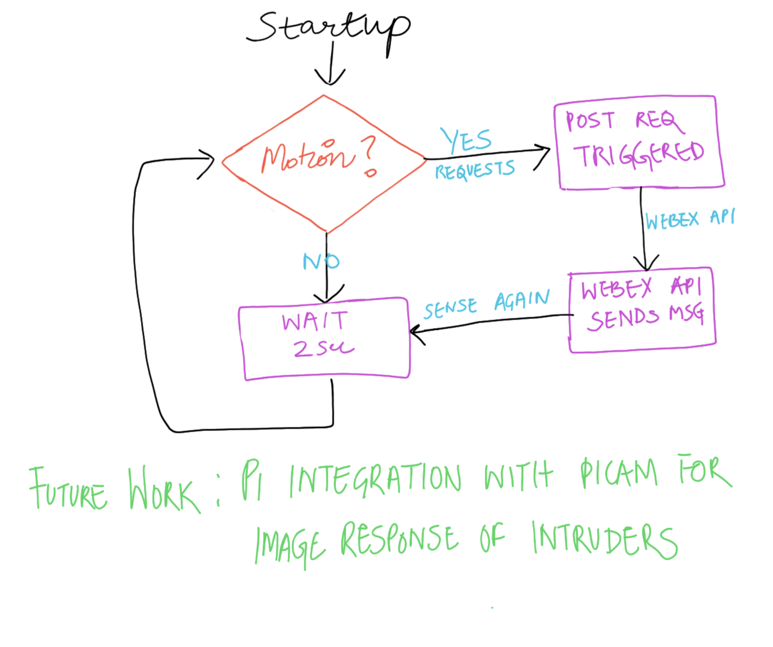
Flowchart!

Slide 5
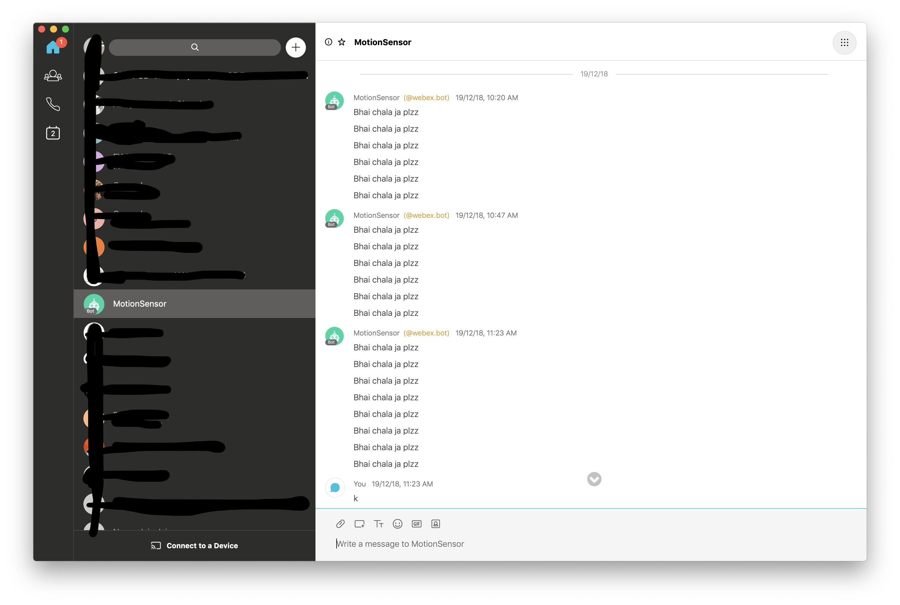
Result

Slide 6
Questions?

Slide 7
Thanks!
Keerti Gautam
Associate Systems Engineer
Cisco Systems, Inc
kegautam@cisco.com

